Slide 1

BeerJS vol. 11 - The b-day edition
Supertest JS - simplified API automation testing

Slide 2

Nebojsha Stamenkov
Lead QA Engineer

Slide 3


01
A little bit of introduction

Slide 4

Possible usage
Will integrate into every other framework
Open source
Under constant update

Slide 5
Faker
Chai
Custom API Test Automation Framework
API testing
Babel
Using multiple test libraries to complete a powerful tool handling different types of APIs
Mocha
Supertest

Slide 6

02
The tech stack usage

Slide 7
Supertest
Supertest is a Node. js library that allows developers and testers to test the APIs.
It enables developers and testers to write automated tests for routes and endpoints. Supertest can be used as a standalone library or with testing frameworks like Mocha and Jest..

Slide 8
Javascript… super(test)!
Mocha framework
Chai assertions
Usage of plain Javascript. Babel helps to toolchain versions and wrap in one powerful output.
Mocha is an open-source JS-based test framework that helps you write better-quality code by running your automated tests in Node. It offers out-of-the-box features for automated tests.
Chai assertion library is an external JS library for assertions. Chai assertions library needs less time & effort and it is easy use. Chai is available by default in the Postman.
Babel
Quasi POM
Versatility
Babel is a tool that lets you write your JS code using all the latest syntax and features, and run it in browsers that may not support those features. Babel is a transpiler that will translate your modern JS code into an older version of JS.
POM in API? Not really, just capturing the classification of the modules to ease the frameworks usage.
Provides an adaptable framework which is developed to capture all types of requests, yet be packaged as a standalone solution or to be addition to a new or already existing framework.

Slide 9
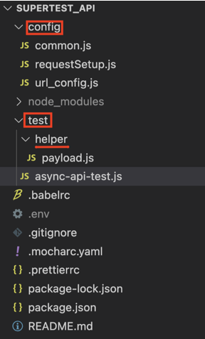
config - this is where the setup is configured
test - main test folder where tests are stored
helper - helper folder contains sufficient .js helper files that hold data (ex. post body, i.e. payloads) for the executables. This can be moved as per users liking, as a separate helper or config module

Slide 10
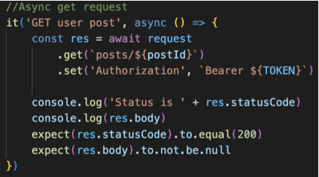
Async execution
When passing a async keyword to a function, it returns a promise, benefiting with:
cleaner code
ordered execution (parallel)
no additional callbacks
easier to scale

Slide 11
RPC
What kind of API types can Supertest handle?
GraphQL
SOAP
API types
While the best practice and wide usage recognizes supertest as a powerful tool to handle both REST and SOAP, there are built in extensions to handle both RPC and GraphQL APIs.
REST
Supertest

Slide 12

03
The workings

Slide 13

Q
A
&

Slide 14

Get your copy

